Slide 1
Units of Measurement for Hydrogeology
Knowledge Transfer

Slide 2
Aims
This document aims to summarise important, and common units of measurement.
Which are used by the hydrogeologist working on mines.
Common conversions between units, e.g. metric and imperial are given

Slide 3
Contents
Levels, Elevations, Depth
Gradients, Angles
Pressure
Volume
Flow
Concentrations of Gas
Chemistry
Energy and Power

Slide 4
Levels and Elevations
mAOD – meters Above Ordnance Datum
Height above sea level
Alternative
mOD
mASL (Above Sea Level )
Negative values, below OD, e.g.:
-30 m AOD, or
30 m BOD (Below OD)

Slide 5
Depth
mBGL – meters Below Ground Level
Alternatives include
mBSL - Below Surface Level
mBDat – Below Datum
mBTOC – Below top of casing
mBEFL – Below Enginehouse floor level
etc
Key point is to understand what reference point (datum) is being measured to.

Slide 6
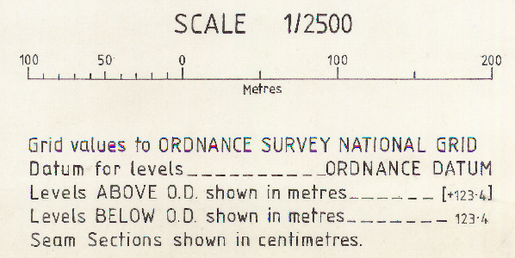
Mine plans – most modern, metric
Since many modern workings are below sea level, to avoid always including the minus symbol (possible confusion with other dashes) convention can be to only label “+”values
200 = -200 mAOD = 200m BOD
+200 = 200 mAOD
Sometimes [ ] placed around values to clearly differentiate +ve values

Slide 7
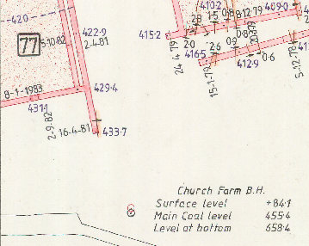
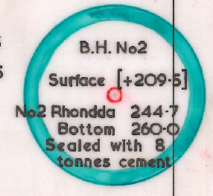
Mine plans – most modern, metric

Slide 8
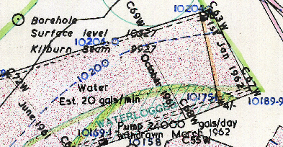
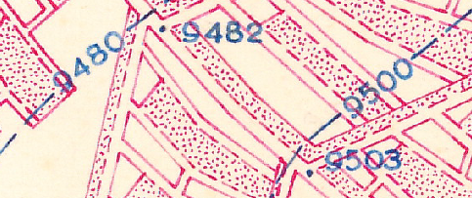
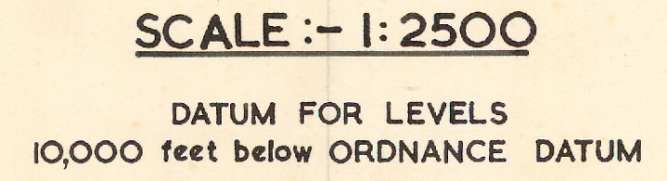
Mine plans – modern, non metric
Commonly use a MINING DATUM
10,000 feet below OD is most common
3048mBOD = 3kmBOD
Cf deepest UK mines ~1km, so avoids negatives
CHECK mine plan legend as others were used

Slide 9
Mine plans – modern, non metric
Two step conversion to mOD
Eg1 : 10,050’AMD (Above Mining Datum).
Datum change : 10,050’ – 10,000’ = 50’AOD
Units change : 50’AOD = 15.2mAOD
Eg2 : 9,775’AMD.
Datum change : 9,775’ – 10,000’ = -225’AOD
Units change : -225’AOD = -68.6mAOD = 68.6mBOD

Slide 10
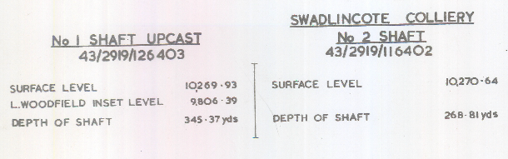

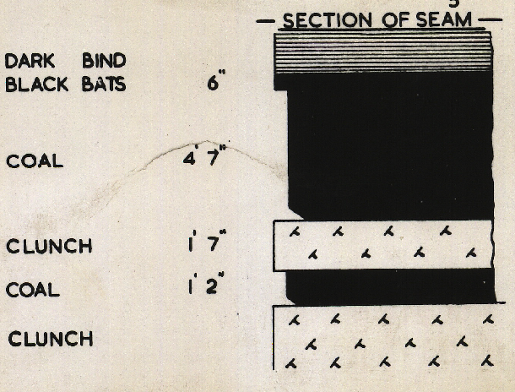
Mine plans – modern, non metric
Depth given in yards – not feet
Accurate elevations use feet with decimal places (not fractions)
Contrasts with use of feet and inches for fault throws e.g.
1/6 = 1 foot 6 inches, or
1/- = 1 foot 0 inch,
and seam sections e.g.
4’7” = 4 feet 7 inches

Slide 11
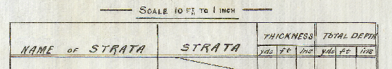
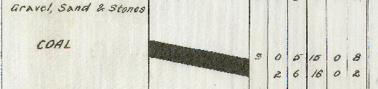
Old mine plans
Fathoms, chains, etc
1 foot (1’) = 12 inches (12”)
1 yard = 3 feet
1 fathom = 2 yards = 6 feet (normally)
1 chain =22 yards

Slide 12
Opencast surface mine plans
Often use a bespoke Site Datum
Avoids dealing with –ve levels when below OD
Eg site datum 0 mSD = -100 mAOD
Need to identify what site datum used:
From legend of plans
By comparing to OS contours on adjacent land

Slide 13
Gradients
Mine infrastructure
1 in 4 e.g. for a drift mine entrance + arrow down
Avoid confusion with arrows for throws on faults!
Flat (ie gradient = zero) often labelled “Level”
Geological Dip
1 in 12 “full dip” annotated arrow pointing down
Hydraulic gradient (slope for water table)
1 in 500
1 in # is very common,
alternatives of using #%, or degrees are rare

Slide 14
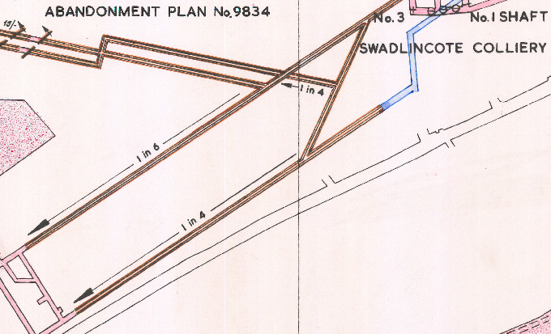
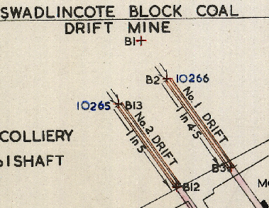
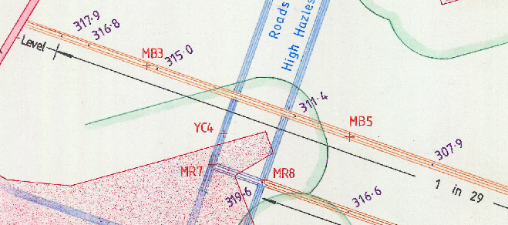
Example of a short “Level” section of cross measures road.
Level =
Flat / Horizontal

Slide 15
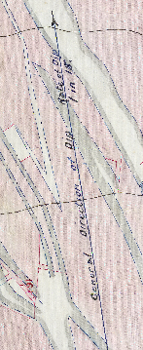
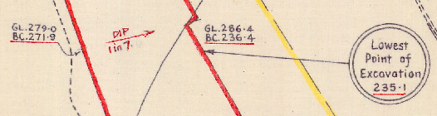
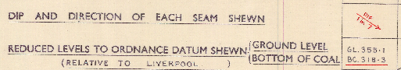
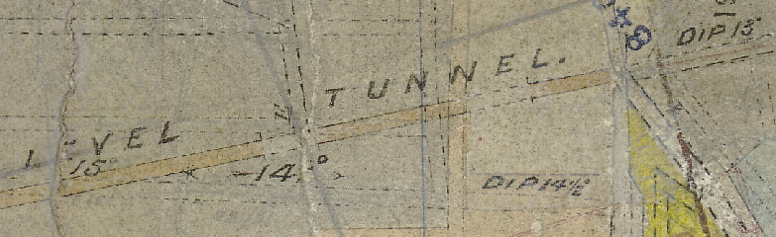

Slide 16
Gradient - Angle conversion
1 in 10 gradient
Tan(a)=dy/dx = 1/10
a= tan⁻¹(dy/dx) = tan⁻¹(0.1) = 5.7º
Phone calculator can do this
Beware – Excel uses radians, so need to convert from degrees:
Gradient dy/dx = TAN(RADIANS(a))
If you input formula correctly, then dy/dx=1 for a=45º
Angle a = DEGREES(ATAN(dy/dx))
dy
Angle a
dx

Slide 17
Borehole angle
Angle
a
dx
A borehole needs to hit a target:
100 m depth (dx)
Horizontal tolerance 1m (dy)
Eg if aiming for centre of 2m wide roadway
dy/dx = 1/100 = 0.01
So max angle of deviation from vertical is:
a= tan⁻¹(dy/dx) = tan⁻¹(0.01) = 0.57º
dy

Slide 18
Pressure
Pressure can be measured in:
Water (and other fluids)
Gas (or more generally air)
Rocks (or any solid material)
Pressure = Force / Area
[Pascal] = [Newton] / [m²]
1 Pa = 1 N/m² = 1 kg/m/s²

Slide 19
Pressure - Water
Piezometric Pressure :
Pressure = Force / Area = Mass.gravity/Area
Multiply top & bottom by depth (h)
Pressure = Mass.gravity.depth/Volume
Pressure = Density.gravity.depth
P = Dgh
units [Pa] = [kg/m³].[m/s²].[m]
Normally pressure is expressed as head of water in meters; but if saline water is present then calculating actual pressure may be useful

Slide 20
Pressure
Alternatives to Pa, kPa, Mpa, include:
Bar
1 bar = 100,000Pa = 100kPa = 10⁵Pa
1 millibar, mb = 100Pa
m H₂0; meters head/depth of water
10 meters water column depth ~ 1 bar
Accurately 10m H₂0 = 0.98 bar
cm H₂0 (eg some pressure sensor loggers)
1 cm H₂0 = ~1mb = ~100 Pa

Slide 21
Pressure
Atmosphere (ie typical atmospheric pressure)
1 atm = 1.013 bar (and ~10m H₂O)
PSI pound per square inch
14.5 psi = 1 bar
mm Hg, millimeters of mercury (rare nowadays)
1 mmHg = 133 Pa

Slide 22
Volume - metric
1000 Litres = 1 m³
1 ML, megalitre = 1000 m³
1 Litre = 1000 cc (cubic centimeters / cm³)

Slide 23
Volume - imperial
Gallons
A UK, or Imperial gallon is ~20% bigger than US gallon, so avoid using US (American) units
Googles converter includes both
1 gallon = 4.55 litres
1 litre = 0.22 gallons
1 m3 = 220 gallons

Slide 24
Flow rates - metric
Flow = Volume / Time
L/s Litres per Second – our usual preference
Alternatives
m³/s, or “cumecs”; cubic meters per second
m³/hr
m³/day
ML/d megalitres per day

Slide 25
Flow rates – metric conversions
Convert to L/s | Conversion factor
1 m3/s = 1000 L/s | x1000
1 m3/hr = 0.28 L/s | x1000/60/60 = /3.6
1 m3/day = 0.012 L/s | x1000/60/60/24 = /86.4
1 ML/d = 11.6 L/s | x1000,000/60/60/24 = x11.6

Slide 26
Flow rates - imperial
Gpm = gallons per minute was common
1 gpm = 0.076 L/s (convert divide by 13.2)
1 L/s = 13.2 gpm
Occasionally see
gph, gallons per hour
gpd, gallons per day

Slide 27
Pumping v Abstraction Rates
Take care to differentiate these similar rates
Pumping rate = instantaneous rate at which flow is delivered by pump
Usual unit = L/s
Abstraction rate = total abstracted (ie pumped) over given time interval (eg 1 day, 1 week etc)
Usual unit = L/s
OR
Abstraction Rate = averaged pumping rate

Slide 28
Pumping v Abstraction Rates
Example – Pump runs at 10 L/s for 12 hrs/day, and is OFF (0 L/s) for 12 hrs per day.
Pumping rate may be recorded as either 0, or 10, depending when the visit occurs in pumping cycle.
Abstraction rate = 10x12/24 = 5 L/s
In practice, pumping rate often > abstraction rate
Note its more accurate to calculate abstraction from volume totalisers, as opposed to estimating using the pumping rate and the hours run totaliser.
Take care with multiple pumps, or totalisers
Different combinations exist

Slide 29
Concentrations - Gas
Can be as ratio of either :
Constituent Volume / total Volume
%v/v (most common; dimensionless)
Constituent Mass / total Volume
mg/L
%w/v where w indicates weight, or mass
For concentrations below the % range:
ppt part per thousand; 1ppt = 0.1%v/v
ppm part per million; 1ppm
ppb part per billion; 1ppb

Slide 30
Concentrations – Methane gas
Normally recorded as
%v/v
But, some instruments report methane relative to explosive range; eg:
% CH4 LEL (methane Lower Explosive Limit)
% CH4 UEL (methane Upper Explosive Limit)
LEL is ~5% CH4 v/v
UEL is ~15% CH4 v/v
Best check instrument instructions to convert from LEL / UEL type readings

Slide 31
Concentrations – Dissolved gas
For testing of dissolved gas take care if the result is reported in the fluid itself, or in an equilibrated headspace above the fluid.
Example units:
mg/L
ccSTP/L -cm3 @ Standard Temperature +Pressure

Slide 32
Chemistry
Concentrations
Loading
Electrical Conductivity
Alkalinity

Slide 33
Concentrations - Water
Concentration = Mass / Volume
mg/L milligram per litre
ug/L microgram per litre: “u” is Greek “mu”
1000 ug/L = 1 mg/L
Sometimes expressed as
ppb part per billion; 1ppb = 1ug/L
ppm part per million; 1ppm = 1mg/L
ppt part per thousand; 1ppt = 1g/L
Above assumes 1 litre fluid has mass 1kg =1000g

Slide 34
Loading (of chemicals in flowing water)
Loading = Concentration x Flow = Mass / Time
E.g. mg/L x L/s = mg/s
Typical alternative units:
Kg/day
Tonne/year

Slide 35
Electrical Conductivity
Siemens per meter, S/m – SI unit
uS/cm is far more common unit in practice
CARE needed for:
uS/cm OR mS/cm ???
Micro units most common in aquatic freshwaters
Milli units can indicate saline waters
Temperature normalised?
EC increases with fluid temperature
Normalise to 25ºC as common reference temperature (nominally “room temperature”)

Slide 36
Electrical Conductivity
Best to state the temperature; e.g.
450 uS/cm @25ºC
Historically 20ºC may have been used!
EC can also be called Specific Conductance, SC,
For geophysical logging of boreholes often both actual EC, and normalised EC recorded – be clear which!
Rule of thumb, each 1ºC increase gives 2% increase in EC value. So
Actual water temperature of 15ºC
EC =1000 uS/cm;
so add (25-15)x2%= 20% to give
EC = 1200 us/cm@25ºC

Slide 37
EC and TDS
Most meters measuring EC will also convert this to Total Dissolved Solids, TDS.
Straightforward for fresh waters, as it’s a linear relationship,
Eg 1000uS/cm = 640 ppm TDS
But becomes non linear as salinity increases.
Typically EC with units of
uS/cm EC converts to ppm TDS
mS/cm EC converts to ppt TDS

Slide 38
Alkalinity
mg/l as CaCO₃ – most common units
The as ??? Is important as it tells you what Alk is when expressed in the equivalent mass of the specified substance
Alkalinity is a concept; not a molecule
Alk = 2CO3²⁻ + HCO3⁻ + OH⁻ - H⁺ [each as mol/l)
Alk = carbonate + bicarbonate + hydroxide – protons
Carbonate ion concentration is doubled due to charge of 2
“Net-Alkalinity” is a different concept, normally relating the alkalinity to the acidity potentially generated from metals

Slide 39
Alkalinity
Can express Alk in charge equivalents (eq)
1meq/l = 50 mg/l as CaCO₃
Occasionally may see eg “carbonate alkalinity”
60 mg/l as CO₃ = 100 mg/l as CaCO₃
By calculating molecular masses:
CaCO₃ = 40 +12 + 3x16 = 40 + 60 = 100

Slide 40
Alkalinity
Measurement in practice (field / lab):
Alkalinity – titrate sample with acid to endpoint, normally at pH=4.5
Acidity– titrate sample with alkali to endpoint, normally at pH=8.3 (variants: cold, hot, peroxide)

Slide 41
Temperature
Degrees Celcius °C
The SI unit
Centigrade is old fashioned name for same scale
Water freezes at 0 °C and boils at 100 °C
Kelvin
Same size as Celsius ; 1 K = 1 °C
Scale starts at absolute zero; 0K = -273.15 °C
Degrees Fahrenheit °F
Used in America

Slide 42
Energy and Power
Mechanical (lifting water)
Electrical (running pumps)
Heat (geothermal energy

Slide 43
Energy and Power - General
Energy (Work done) = Force x Distance
Energy SI unit = Joule
kJ, or MJ common
Power = Energy/ Time (rate of use of energy)
Power SI Unit = Watt
1 Watt = 1 Joule/second
1kW = 1 kJ/s = 1000 J/s
Energy = Power x Time

Slide 44
Energy and Power - Mechanical
To move water up (or down)
Energy = Force x Distance
Energy = mass x gravity x height (i.e. mgh)
[J] = [kg] x [m/s²] x [m]
Often called Potential Energy, PE
Hydropower turbines convert PE into electric energy (the opposite of pumps)

Slide 45
Energy and Power - Mechanical
Power needed to lift a steady flow Q of water
Power = Energy/ Time
Power = mgh/t = (m/t).gh
Since flow Q = V/t and density D = m/V
DQ = m/t
Power = D.Q.gh
[W] = [kg/m³].[m³/s].[m/s²].[m]
Or [W] = [kg/L].[L/s].[m/s²].[m]
So for fresh water density 1kg/L, Power = Qgh
9.8W needed to lift 1L/s by 1m

Slide 46
Energy and Power - Electrical
Energy = Power x Time
Hence kiloWatt-hours, kWh common
1 kWh = 1000x60x60 = 3.6MJ
Avoid confusing kW with kWh ! ( common!)
Calculate electrical power by
Power = Voltage . Ampage(current) [VA]
But beware power supplies are rated as kVA, but due to efficiency factors kVA is similar but not identical to kW!

Slide 47
Energy and Power - Heat
Heat extractable from a substance depends on
specific heat capacity, c, of substance
For water, c= 4,200 J/kg/°C
change in temperature dT (in °C, or K, Kelvin)
Energy = c.mass.dT
[J] = [J/kg/°C]. [kg].[°C]
So lowering 1kg water by 5°C provides:
Heat energy = 4200x1x5 = 21,000J = 21kJ
Converts to 6Wh; equivalent to running an energy efficient 6Watt light bulb for an hour

Slide 48
Energy and Power - Heat
Other units for heat energy, include:
Calories
1 calorie = 4.2 J
British Thermal Units
1 btu = 1055 J

Slide 49
Energy and Power - Heat
Power = Energy/ Time
Power = c.mass.dT / Time = (m/t).c.dT
Since flow Q = V/t and density D = m/V
D.Q = m/t
Power = D.Q.c.dT
[W] = [kg/m³].[m³/s] [J/kg/°C].[°C] = [J/s]
Or [W] = [kg/L].[L/s] [J/kg/°C].[°C]
So for fresh water density 1kg/L, Power = Q.c.dT
Power = 1 x 4200 x 5 = 21,000 W
21kW released from 1L/s with a 5ºC change

